Slide 1
Bandwidth and Propagation Delay Exercises ANS
Links
Bandwidth and Propagation Delay
Pipe Diagrams
Overloaded Links
Lecture 3, Spring 2026
Notes:
so here's the outline we're going
38:16
to start by talking about links in a lot of detail think about how you measure the performance of links what makes a
38:21
link good what makes a link bad what are the trade-offs we'll talk about what happens if links get overloaded and then
38:27
the very end now that we finished all of the introduction I can actually give you a preview of all the topics you're going
38:33
to see in a lot more detail so these three sets of lectures have really been about giving you a highlevel 10,000 foot
38:39
picture of what you're going to see this semester and then at the very end I'll show you the exact places where we'll be
38:45
really diving in and talking about things in lots more detail but before we get there let's not get ahead of
38:50
ourselves let's start with talking about links and how to measure their performanc

Slide 2

Packet delay: four sources
IMPORTANT
transmission
A
propagation
The nodal processing delay (check bit errors, determine output link) is typically very small and can be ignored
B
queueing
d_{nodal} = d_{queue} + d_{trans} + d_{prop}
d_{q}: queueing delay
time waiting at output link for transmission
depends on congestion level of router
d_{tx}: transmission delay:
L: packet length (bits)
R: link transmission rate (bps)
d_{trans} = L/R
d_{prop}: propagation delay:
d: length of physical link
s: propagation speed (~2x10⁸ m/sec)
d_{prop} = d/s
Notes:
d_{proc}: nodal processing
check bit errors
determine output linknodal processing
typically < microsecs

Slide 3
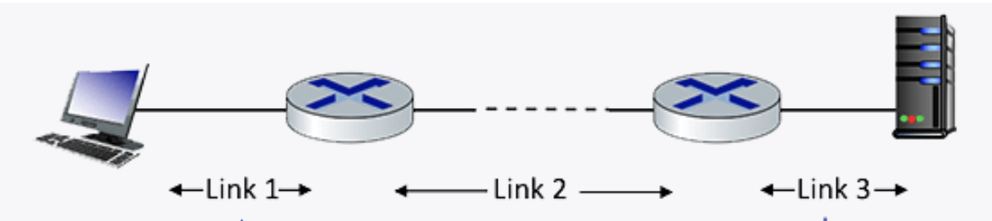
Q1 End-­to­‐end delay
Consider the network shown in the figure, with three links, each with a transmission rate of 1 Mbps, and a propagation delay of 1 msec per link. Assume the length of a packet is 1000 bits.
What is the end-end delay of a packet from when it first begins transmission on link 1, until is it received in full by the server at the end of link 3. Assume that queueing delays are zero.
Notes:
Each link has transmission delay 1000 bits/1 Mbps = 1ms. So each link has total delay of transmission + propagation = 1+1=2 ms.
For the three links, the total delay = 2 + 2 + 2 = 6 ms. `

Slide 4
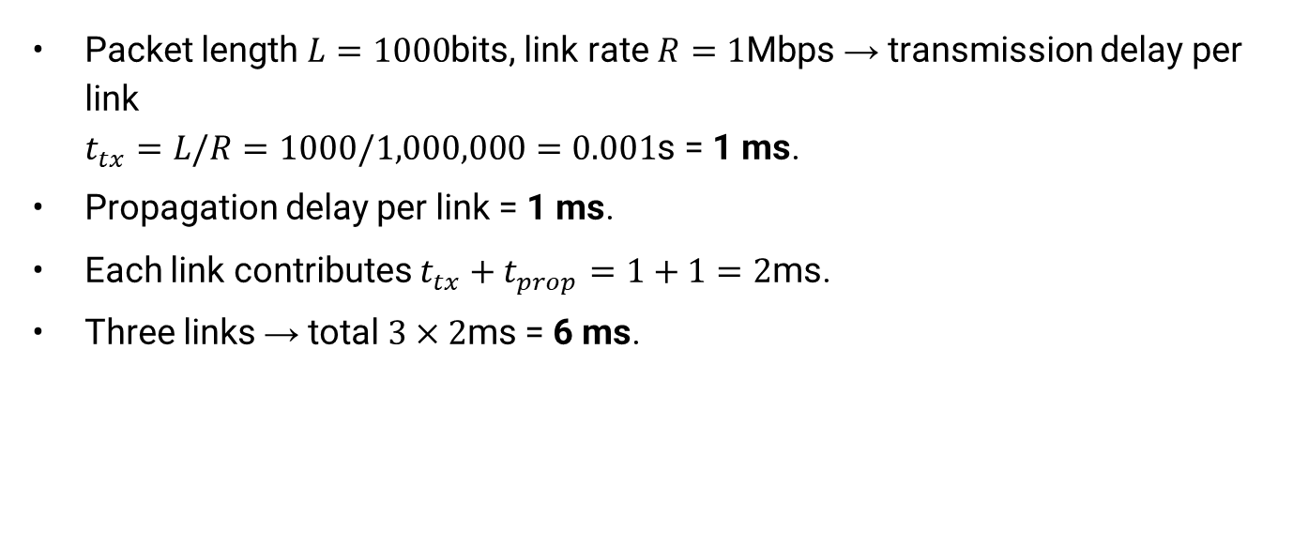
Q1 End-­to­‐end delay ANS
Packet length $L=1000$bits, link rate $R=1$Mbps → transmission delay per link $t_{tx}=L/R=1000/1,000,000=0.001$s = 1 ms.
Propagation delay per link = 1 ms.
Each link contributes $t_{tx}+t_{prop}=1+1=2$ms.
Three links → total $3×2$ms = 6 ms.

Slide 5
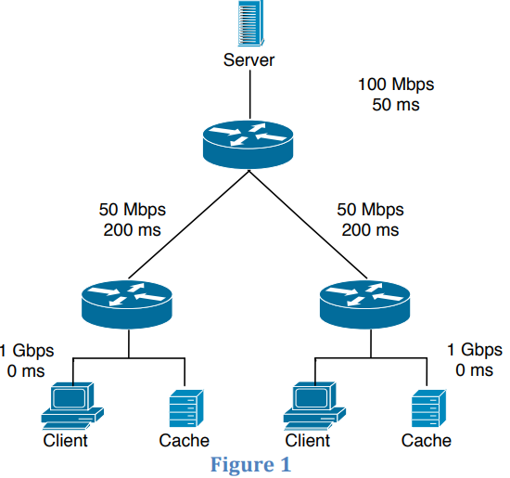
Q2 End-­to­‐end delay
Consider the scenario shown in Figure 1: a server is connected to a router by a 100Mbps link with a 50ms propagation delay. This router is connected to two other routers, each over a 50Mbps link with a 200ms propagation delay. A 1Gbps link connects each host to each of these routers with 0 propagation delay. All packets in the network have size of 20,000 bits.
What is the end-­to­‐end delay (in ms) from when a packet is transmitted by the server to when it is received by the client? Assume there’s no queuing delay at the routers.

Slide 6
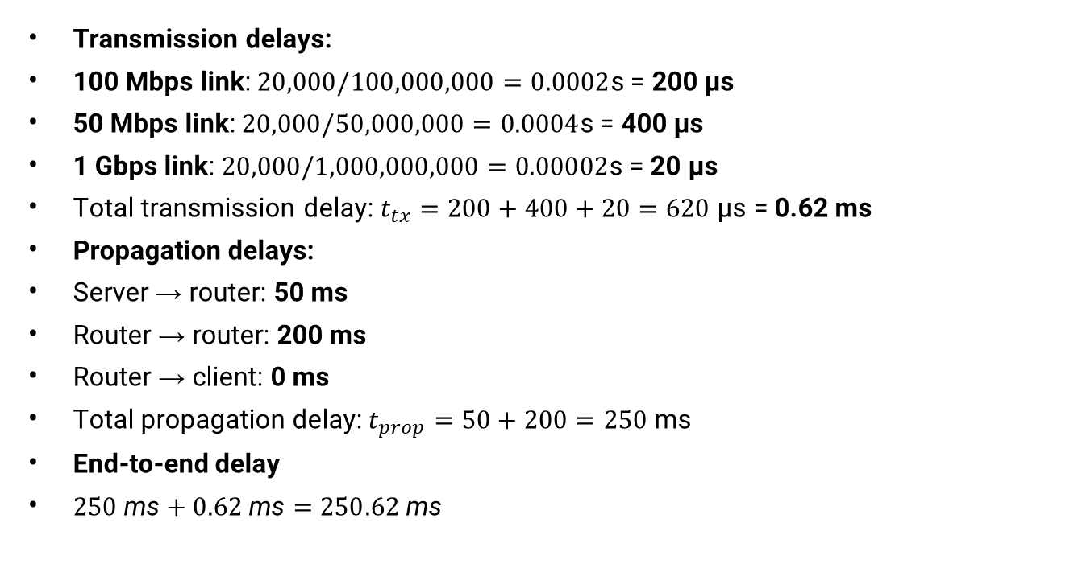
Q1 End-­to­‐end delay ANS
Transmission delays:
100 Mbps link:$20,000/100,000,000=0.0002$s = 200 μs
50 Mbps link:$20,000/50,000,000=0.0004$s = 400 μs
1 Gbps link:$20,000/1,000,000,000=0.00002$s = 20 μs
Total transmission delay: $t_{tx}=200+400+20=620$ μs = 0.62 ms
Propagation delays:
Server → router: 50 ms
Router → router: 200 ms
Router → client: 0 ms
Total propagation delay:$t_{prop}=50+200=250$ms
End-to-end delay
$250 \text{ms}+0.62 \text{ms}=$ $250.62 \text{ms}$
Notes:
ANS: If all packets are 20,000 bits long it takes 200 us to send the packet over the 100Mbps link, 400 usec to send over the 50Mbps link, and 20 us to send over the 1Gbps link. Sum of the three-link transmission is 620 us = 0.62 ms. Thus, the total end-to-end delay is 250 + 0.62 = 250.62 ms.
(Detailed calculations shown on the right.)

Slide 7

Q3 End-­to­‐end delay
Consider a 100 Mbps link between an earth station (sender) and a satellite (receiver) at an altitude of 2100 km. The signal propagates at a speed of $3×{10}^{8}$m/s. Calculate the time taken (in ms) for the receiver to receive a packet of 1000 bytes transmitted by the sender. (There is no router so there is no queuing delay.)

Slide 8
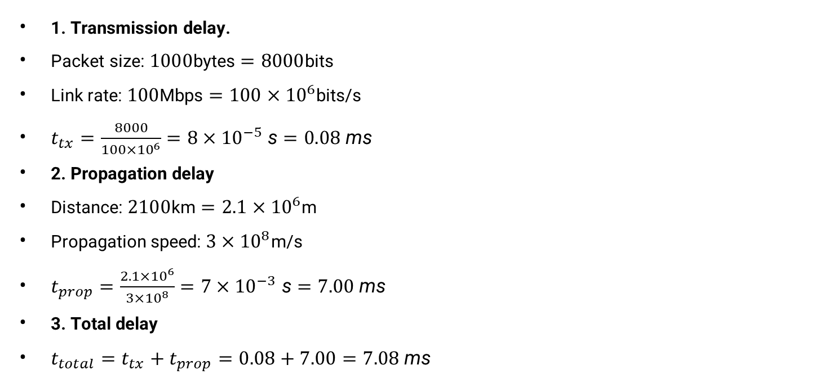
Q3 End-­to­‐end delay ANS
1. Transmission delay.
Packet size:$1000$bytes $=8000$bits
Link rate:$100$Mbps $=100×{10}^{6}$bits/s
$t_{tx}=\frac{8000}{100×{10}^{6}}=8×{10}^{−5} \text{s}=0.08 \text{ms}$
2. Propagation delay
Distance:$2100$km $=2.1×{10}^{6}$m
Propagation speed:$3×{10}^{8}$m/s
$t_{prop}=\frac{2.1×{10}^{6}}{3×{10}^{8}}=7×{10}^{−3} \text{s}=7.00 \text{ms}$
3. Total delay
$t_{total}=t_{tx}+t_{prop}=0.08+7.00=7.08 \text{ms}$

Slide 9

Q4 End-­to­‐end delay
Consider two computers X and Y connected via a single link of bandwidth 512 Gbps. Suppose that both hosts are separated by distance M meters, and the propagation delay along the link is $2×{10}^{9}$meters/sec. Computer X has to send a packet of size 1 Kbyte to computer Y. What will be the distance M such that the propagation delay is equal to the transmission delay?

Slide 10
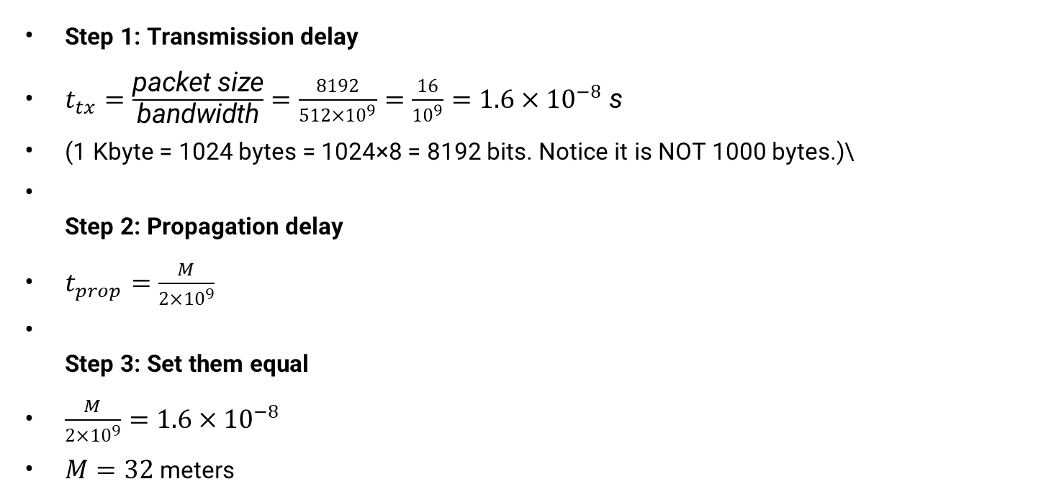
Q4 End-­to­‐end delay ANS
Step 1: Transmission delay
$t_{tx}=\frac{\text{packet} \text{size}}{\text{bandwidth}}=\frac{8192}{512×{10}^{9}}=\frac{16}{{10}^{9}}=1.6×{10}^{−8} \text{s}$
(1 Kbyte = 1024 bytes = 1024×8 = 8192 bits. Notice it is NOT 1000 bytes.)\
Step 2: Propagation delay
$t_{prop}=\frac{M}{2×{10}^{9}}$
Step 3: Set them equal
$\frac{M}{2×{10}^{9}}=1.6×{10}^{−8}$
$M=32$ meters

Slide 11

Q5 Transmission delay
1. Calculate transmission delay for message size $L=8000$bits, network bandwidth $B=8000$bits/sec
ANS:
2. Calculate transmission delay for message size $L=\text{1} \text{Kbyte}\text{s}$, network bandwidth $B=8 \text{Kbps}$
ANS:
Notes:
Computer Networks 14 | Delay in Computer Network | CS & IT | GATE Crash Course
https://www.youtube.com/watch?v=vXyNFzq7Ixc&list=PL3eEXnCBViH-hlNCNwdfV7VrEcTquANGa&index=15

Slide 12
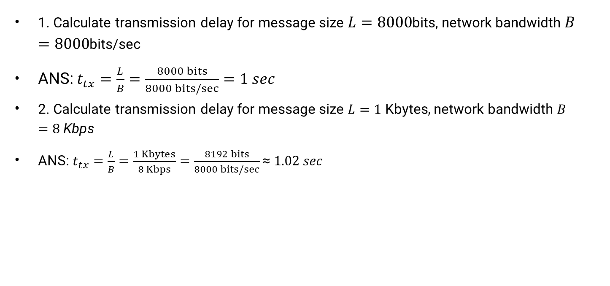
Q5 Transmission delay ANS
1. Calculate transmission delay for message size $L=8000$bits, network bandwidth $B=8000$bits/sec
ANS: $t_{tx}=\frac{L}{B}=\frac{8000 bits}{8000 bits/sec}=1 sec$
2. Calculate transmission delay for message size $L=\text{1} \text{Kbyte}\text{s}$, network bandwidth $B=8 \text{Kbps}$
ANS:$t_{tx}=\frac{L}{B}=\frac{1 Kbytes}{8 Kbps}=\frac{8192 bits}{8000 bits/sec}\text{≈} 1.02 sec$
Notes:
Computer Networks 14 | Delay in Computer Network | CS & IT | GATE Crash Course
https://www.youtube.com/watch?v=vXyNFzq7Ixc&list=PL3eEXnCBViH-hlNCNwdfV7VrEcTquANGa&index=15

Slide 13
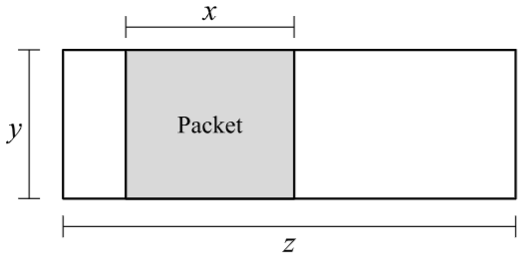
Q5.1 Pipe Diagram
Consider the pipe diagram, with a single packet in the pipe.
1) What is the size of this packet?
2) How long does it take to send a packet of the same size as the packet shown?(Count from the time the first byte is sent, to the time the last byte is received.)
3) How long does it take to send 7 packets, all of the same size as the packet shown?(Count from the time the first byte of the first packet is sent, to the time the last byte of the last packet is received.)
4) What is the maximum number of packets that could be in the process of being sent alongthis link, at any given moment?Don’t worry about fractions and rounding (e.g. assume 𝑥, 𝑦, and 𝑧 are defined such that all answerchoices are integers).

Slide 14
Q5.1 Pipe Diagram ANS
1) What is the size of this packet?
ANS: xy. 𝑥 is the transmission delay (time it takes to transmit the packet).𝑦 is the bandwidth of the link, i.e. how many bytes can be sent per second. Multiplying 𝑥 (seconds) and 𝑦 (bytes/second) gives the overall size of this packet.
2) How long does it take to send a packet of the same size as the packet shown?(Count from the time the first byte is sent, to the time the last byte is received.)
ANS: 𝑥 + 𝑧. 𝑥 is the transmission delay (time it takes to transmit the packet). 𝑧 is the propagation delay.
3) How long does it take to send 7 packets, all of the same size as the packet shown?(Count from the time the first byte of the first packet is sent, to the time the last byte of the last packet is received.)
ANS: 7𝑥 + 𝑧. 𝑥 is the transmission delay, so it takes 7𝑥 seconds to transmit all 7 packets. 𝑧 is the propagation delay.
4) What is the maximum number of packets that could be in the process of being sent along this link, at any given moment?Don’t worry about fractions and rounding (e.g. assume 𝑥, 𝑦, and 𝑧 are defined such that all answer choices are integers).
ANS: z/x. 𝑥 is the transmission delay, 𝑧 is the propagation delay. The maximum number of packets that can be in flight therefore is 𝑧/𝑥 .
5) In this subpart, suppose R1 has 1 other packet in its queue when A sends the packet. How long does it take to send a single packet from A to B?
6) In this subpart, suppose R1 has 20 other packets in its queue when A sends the packet.How long does it take to send a single packet from A to B? Assume that the queue at R1 is notempty when this packet arrives at R1.
7) What is the maximum number of packets that can be queued at R1, such that when thelast byte of the A-to-B packet reaches R1, there is no queue at R1?Don’t worry about fractions and rounding (e.g. assume 𝑥, 𝑦, and 𝑧 are defined such that all answerchoices are integers).

Slide 15
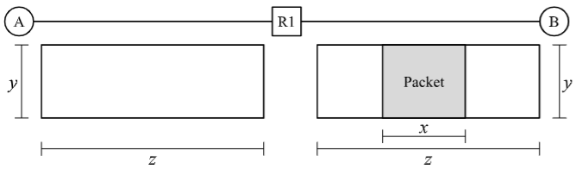
Q5.2 Pipe Diagram
Now, consider the network topology with a Router R1, which has an infinite-size queue, and R1 continually processes packets in its queue in FIFO order. R1 can only start transmitting a packet once it has received the entire packet. All packets are the same size as the packet shown in the diagram in Q5.1. A wants to send a packet to B. No other packets are being sent along the links (i.e. suppose the packet in the diagram is not there).In the next two subparts, select how long it takes to send the packet from A to B. Count from the time the first byte of the packet is sent at A, to the time the last byte of the packet is received at B.
5) In this subpart, suppose R1 has 1 other packet in its queue when A sends the packet. How long does it take to send a single packet from A to B?
6) In this subpart, suppose R1 has 20 other packets in its queue when A sends the packet. How long does it take to send a single packet from A to B? Assume that the queue at R1 is notempty when this packet arrives at R1.
7) What is the maximum number of packets that can be queued at R1, such that when thelast byte of the A-to-B packet reaches R1, there is no queue at R1? Don’t worry about fractions and rounding (e.g. assume 𝑥, 𝑦, and 𝑧 are defined such that all results of division are integers.)

Slide 16
Q5.2 Pipe Diagram ANS
5) In this subpart, suppose R1 has 1 other packet in its queue when A sends the packet. How long does it take to send a single packet from A to B?
ANS: 2x + 2z. Since all packets are the same size, by the time A transmits the packet onto the A-to-R1 link, R1has finished clearing out its queue. Therefore, there will be no queuing delay at R1.The packet takes 𝑥 + 𝑧 time to travel from A to R1 (transmission delay 𝑥 and propagation delay𝑧). At time 𝑥 + 𝑧, R1 has received the entire packet.R1 then must send the packet along the R1-to-B link, which takes 𝑥 + 𝑧 time again. The total time to transmit the packet from A to B is 2(𝑥 + 𝑧) = 2𝑥 + 2𝑧.
6) In this subpart, suppose R1 has 20 other packets in its queue when A sends the packet. How long does it take to send a single packet from A to B? Assume that the queue at R1 is not empty when this packet arrives at R1.
ANS: 21𝑥 + 𝑧. By the time the A-to-B packet arrives at R1, the queue is not empty (per the assumption).Therefore, we have to account for queuing delay. More specifically, we have to wait for R1 to finish sending all 20 packets, and then it can send the A-to-B packet. The time it takes for R1 to transmit 21 packets (the 20 in the queue, plus the A-to-B packet) is21𝑥.Then, the time it takes for the A-to-B packet to propagate along the R1-to-B link is 𝑧.Thus, the total packet delay is 21𝑥 + 𝑧.Note that we don’t need to consider the delay on the A-to-R1 link, because we already counted that time in the 21𝑥 term (i.e. the packet was sent from A to R1 while R1 was clearing out it’s the first packet in its queue).
7) What is the maximum number of packets that can be queued at R1, such that when the last byte of the A-to-B packet reaches R1, there is no queue at R1?Don’t worry about fractions and rounding (e.g. assume 𝑥, 𝑦, and 𝑧 are defined such that all results of division are integers).
ANS: (x + z)/x. The time it takes to send the packet from A to R1 is 𝑥 + 𝑧.R1 needs 𝑥 seconds to send out each packet.Therefore, in 𝑥 + 𝑧 seconds, R1 is able to send out 𝑥+𝑧𝑥 packets. Therefore, R1 can have at most 𝑥+𝑧𝑥 packets in its queue, and all of those packets will be sent outby the time the last byte of the A-to-B packet reaches R1.

